Slide 1

8086 signal description and physical memory organization
By
G HARISH BABU M.TECH, (Ph.D)
Asst Professor
Dept of ECE
CVR COLLEGE OF ENGINEERING

Slide 2
SIGNAL DESCRIPTION OF 8086

Slide 3
The 8086 Microprocessor is a 16-bit CPU available in 3 clock rates, i.e. 5, 8 and 10MHz, packaged in a 40 pin CERDIP or plastic package.
The 8086 Microprocessor operates in single processor or multiprocessor configurations to achieve high performance.
Some of the pins serve a particular function in minimum mode (single processor mode) and others function in maximum mode (multiprocessor mode) configuration.

Slide 4
The 8086 signals can be categorized in three groups.
The first are the signals having common functions in minimum as well as maximum mode
The second are the signals which have special functions in minimum mode.
Third are the signals having special functions for maximum mode

Slide 5
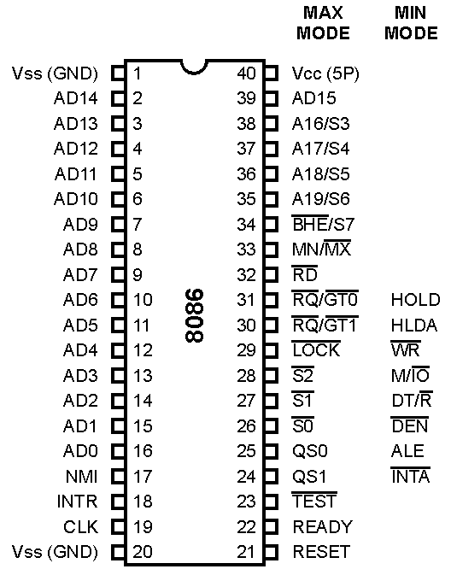
SIGNAL DESCRIPTION OF 8086

Slide 6
AD15-AD0:
These are the time multiplexed memory I/O address and data lines.
Address remains on the lines during T1 state, while the data is available on the data bus during T2, T3, TW and T4.
Here T1, T2, T3, T4 and TW are the clock states of a machine cycle.
TW is await state.
These lines are active high and float to a tristate during interrupt acknowledge and local bus hold acknowledge cycles.

Slide 7
T1
T2
T3
T4
T1
T2
MACHINE CYCLE

Slide 8
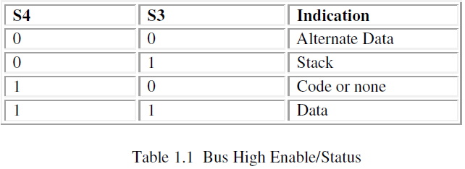
A19/S6, A18/S5, A17/S4, A16/S3:
These are the time multiplexed address and status lines.
During T1, these are the most significant address lines or memory operations.
During I/O operations, these lines are low. During memory or I/O operations, status information is available on those lines for T2, T3, TW and T4 .
The status of the interrupt enable flag bit(displayed on S5) is updated at the beginning of each clock cycle.

Slide 9
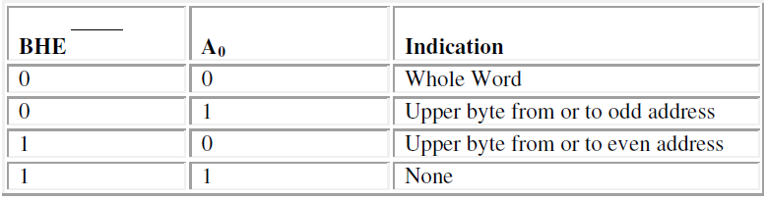
BHE/S7- BUS ENABLE/STATUS

Slide 10
Read signal, when low, indicates the peripherals that the processor is performing a memory or I/O read operation.
Is active low and shows the state for T2, T3, TW of any read cycle.
The signal remains tristated during the 'hold acknowledge'.

Slide 11
READY:
This is the acknowledgement from the slow devices or memory that they have completed the data transfer.
The signal made available by the devices is synchronized by the 8284A clock generator to provide ready input to the 8086. The signal is active high.

Slide 12
INTR-lnterrupt Request:
This is a level triggered input.
This is sampled during the last clock cycle of each instruction to determine the availability of the request.
If any interrupt request is pending, the processor enters the interrupt acknowledge cycle.
This can be internally masked by resetting the interrupt enable flag. This signal is active high and internally synchronized.

Slide 13
TEST:
This input is examined by a 'WAIT' instruction.
If the TEST input goes low, execution will continue, else, the processor remains in an idle state.
The input is synchronized internally during each clock cycle on leading edge of clock.

Slide 14
NMI-Non-maskable Interrupt:
This is an edge-triggered input which causes a Type2 interrrupt. The NMI is not maskable internally by software.
A transition from low to high initiates the interrupt response at the end of the current instruction.
This input is internally synchronized.

Slide 15
RESET:
This input causes the processor to terminate the current activity and start execution from FFFF0H.
The signal is active high and must be active for at least four clock cycles.
It restarts execution when the RESET returns low. RESET is also internally synchronized.

Slide 16
CLK-Clock Input:
The clock input provides the basic timing for processor operation and bus control activity.
Its an asymmetric square wave with 33% duty cycle. The range of frequency for different 8086 versions is from 5MHz to 10MHz.

Slide 17
VCC :
+5V power supply for the operation of the internal circuit. GND ground for the internal circuit. MN/MX :
The logic level at this pin decides whether the processor is to operate in either minimum (single processor) or maximum (multiprocessor) mode.
The following pin functions are for the minimum mode operation of 8086.

Slide 18
MINIMUM MODE

Slide 19
M/IO -Memory/IO:
This is a status line logically equivalent to S2 in maximum mode.
When it is low, it indicates the CPU is having an I/O operation.
When it is high, it indicates that the CPU is having a memory operation.
This line becomes active in the previous T4 and remains active till final T4 of the current cycle. It is tristated during local bus "hold acknowledge".

Slide 20
-Interrupt Acknowledge:
This signal is used as a read strobe for interrupt acknowledge cycles.
In other words, when it goes low, it means that the processor has accepted the interrupt.
It is active low during T2, T3 and TW of each interrupt acknowledge cycle.
ALE-Address latch Enable:
This output signal indicates the availability of the valid address on the address/data lines, and is connected to latch enable input of latches.
This signal is active high and is never tristated

Slide 21
DT/R -Data Transmit/Receive:
This output is used to decide the direction of data flow through the transreceivers (bidirectional buffers).
When the processor sends out data, this signal is high and when the processor is receiving data, this signal is low.
Logically, this is equivalent to S1 in maximum mode. Its timing is the same as M/I/O. This is tristated during 'hold acknowledge'.

Slide 22
This signal indicates the availability of valid data over the address/data lines.
It is used to enable the transreceivers (bidirectional buffers) to separate the data from the multiplexed address/data signal.
It is active from the middle of T2 until the middle of T4 DEN is tristated during 'hold acknowledge' cycle

Slide 23
MAXIMUM MODE

Slide 24
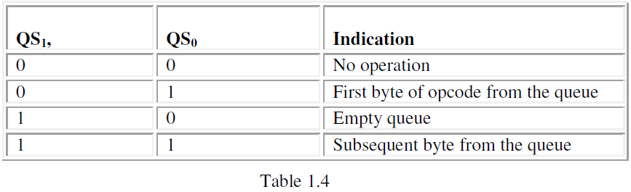
QS1, QS0-Queue Status:
These lines give information about the status of the code prefetch queue.
These are active during the CLK cycle after which the queue operation is performed.

Slide 25
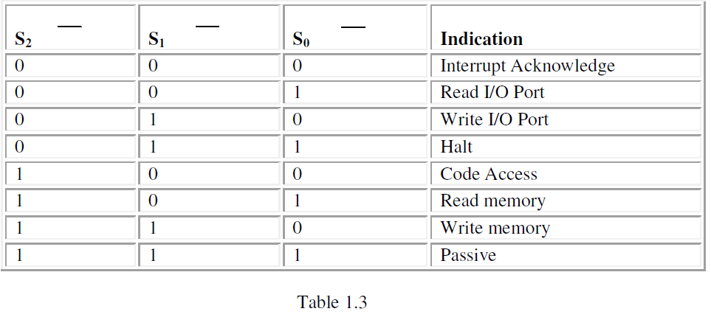
S2, S1, S0 -Status Lines:
These are the status lines which reflect the type of operation , being carried out by the processor.
These become active during T4 of the previous cycle and remain active during T1 and T2 of the current bus cycle.

Slide 26
This output pin indicates that other system bus masters will be prevented from gaining the system bus, while the signal is low.
The signal is activated by the 'LOCK' prefix instruction and remains active until the completion of the next instruction.
This floats to tri-state off during "hold acknowledge".

Slide 27
ReQuest/Grant:
These pins are used by other local bus masters, in maximum mode, to force the processor to release the local bus at the end of the processor's current bus cycle.
Each of the pins is bidirectional with having higher priority than pins have internal pull-up resistors and may be left unconnected.

Slide 28
PHYSICAL MEMORY ORGANISATION

Slide 29
8086 MEMORY ORGANIZATION
8086 supports 2²⁰ = 1,048,576 bytes (1Mbytes) of memory over the address range 00000₁₆ to FFFFF₁₆ (00000H to FFFFFH)
Two consecutive bytes can be accessed as one word (16-bits)
The lower-addressed byte is the least significant byte of the word, and the higher-addressed byte is its most significant byte
Address of lower byte of word is called address of the full word
Memory space of 1MB is divided into two chips (called banks) of 512KB each having even & odd addresses
This is done because most memories are ‘byte-oriented’ (1 byte read/write at a time), but as 8086 is capable to read/write 16-bit (2 bytes) at a time, we need to use two chips for 16-bit word operations
Two banks have alternate addresses because 16-bit words are stored in consecutive locations & at the same time 8086 must access both banks simultaneously for 16-bit operations
If we had used only 1 chip of 1MB, 8086 could read only 1 byte at a time & thus would need two operations (bus cycles) for every 16-bit word operation. Thus process would have been slower.

Slide 30
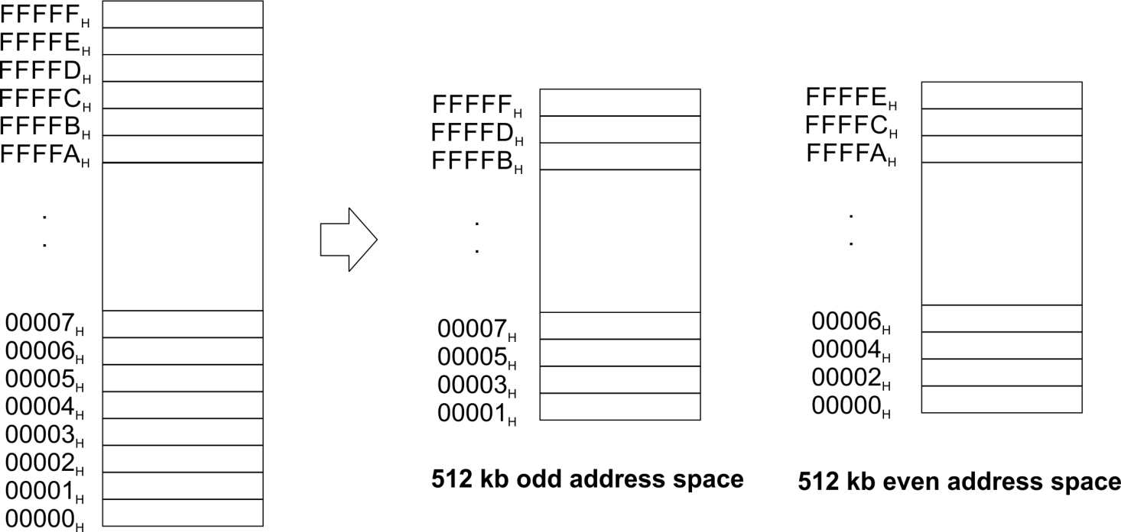
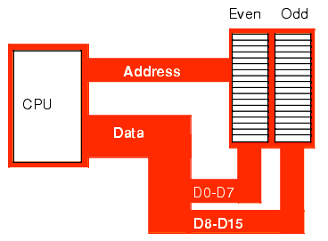
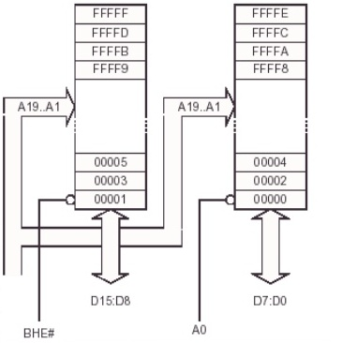

Slide 31
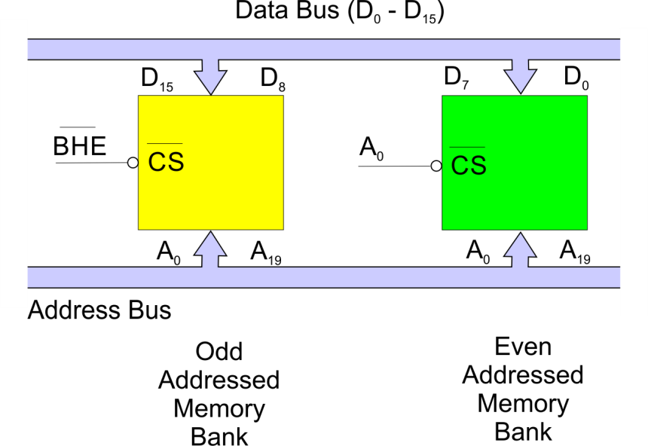
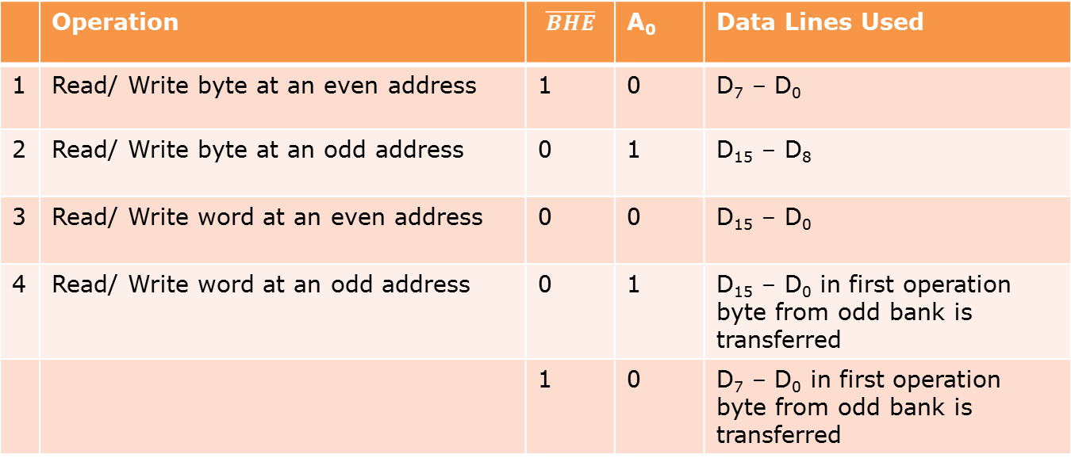
8086 MEMORY ORGANIZATION
 | Operation |  | A₀ | Data Lines Used
1 | Read/ Write byte at an even address | 1 | 0 | D₇ – D₀
2 | Read/ Write byte at an odd address | 0 | 1 | D₁₅ – D₈
3 | Read/ Write word at an even address | 0 | 0 | D₁₅ – D₀
4 | Read/ Write word at an odd address | 0 | 1 | D₁₅ – D₀ in first operation byte from odd bank is transferred
 |  | 1 | 0 | D₇ – D₀ in first operation byte from odd bank is transferred
8086
D15-D0
(Also called BLE)
A19-A1

Slide 32
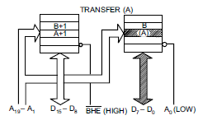
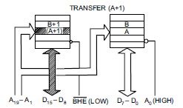
BYTE/WORD TRANFER IN 8086
A, B = any assumed memory location address in even, odd banks. Brackets indicate contents of location & not address

Slide 33
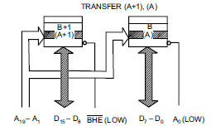
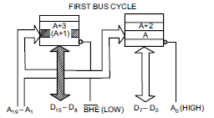
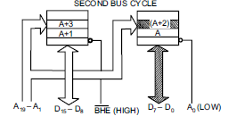
BYTE/WORD TRANFER IN 8086
Aligned
word
Misaligned
word
A word stored at an even-address boundary (00000H, 00002H, 00004H etc) is said to be an aligned word while a word stored at an odd address boundary (00001H, 00003H, 00005H etc) is called misaligned word. A misaligned word requires two read operations (or bus cycles) & thus double time

Slide 34
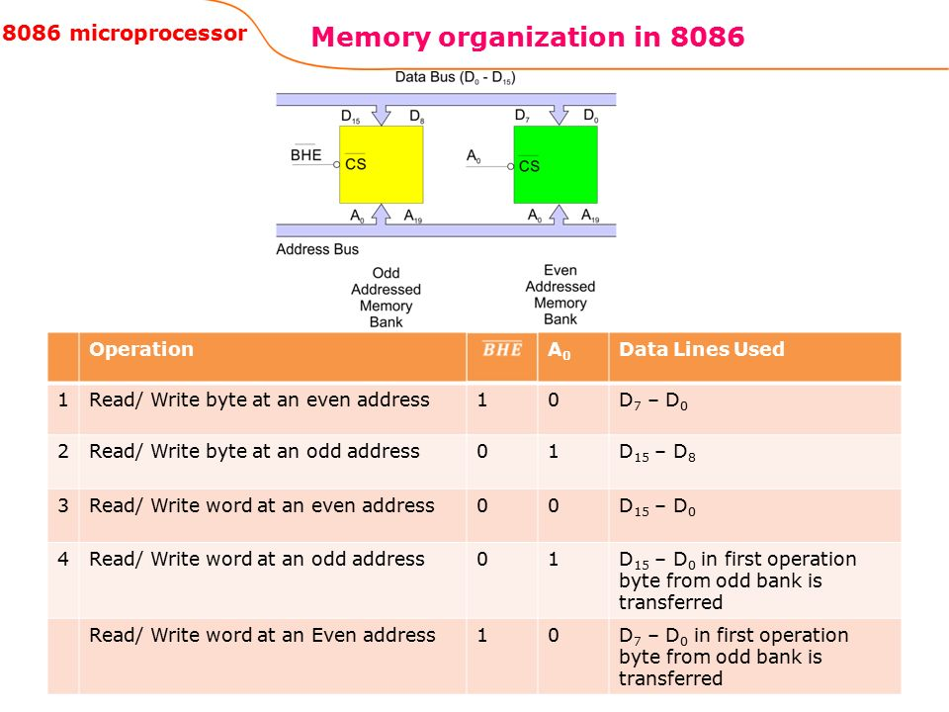

Slide 35
